Slide 1


Reporter: 資訊所 P78991121 Yung-Chih Cheng (鄭詠之)

Slide 2

Introduction
Data Collection
System Architecture
Feature Extraction
Recognition Methods
Results and Discussion
Conclusion

Slide 3

Character recognition is becoming more and more important in the modern world.
Handwritten recognition is not a new technology
Optical Character Recognition(OCR)
  Automatic reading of optically sensor
  Document text materials to translate human-readable character to machine readable codes

Slide 4

Less work has been reported for the recognition of Indian Languages.
  Complexity of the shape
  Large set of different patterns
Propose a new elastic image matching technique based on an eigen-deformation
  Offline isolated English uppercase handwritten characters
  Offline isolated handwritten character of Devnagari

Slide 5

ETL6 standard database is used
  Japanese Characters
  English Capital letters [A-Z]
  Digits [0-9]
  .pgn file format
  Image size: 64 x 63
Collect 500 data samples from different individuals of various professions for the experimetn.

Slide 6

Devnagari is the most popular script in Indian and the most popular Indian language Hindi is written an Devnagari script
  National language of India
  The third most popular language in the world
  14 vowels and 33 consonants
  Left to right
In this paper, considering 12 basic character

Slide 7

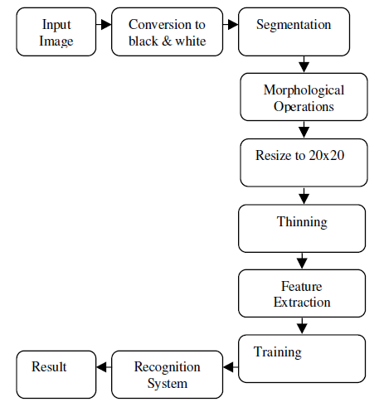


Slide 8

Preprocessing
  Filtering
  Morphological operation
  Normalization
    Segmentation
      Horizontal Segmentation
      Vertical Segmentation
    Size Normalization

Slide 9

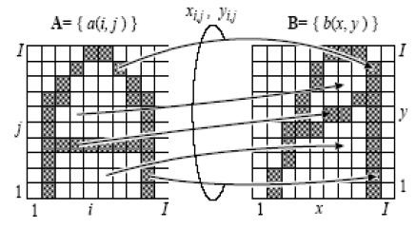
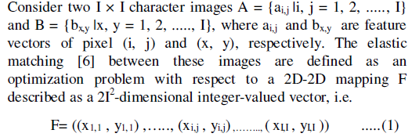
Elastic Matching

Slide 10

Properties of Elastic Matching(EM)
  Anisotropic
  Asymmetric
    The distance between image T and R
    R is deformed by F for optimal matching T and R
  Symmetric
    Sum of two asymmetric distances is simplest and gives result than individual asymmetric elastic matching tecnique

Slide 11

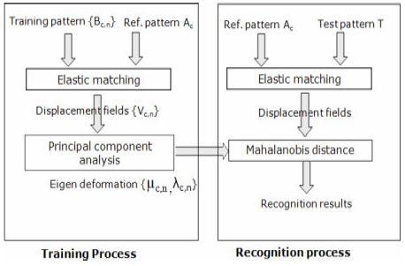
With Eigen-deformations(PCA)
  Training Phase
  Recognition Phase

Slide 12

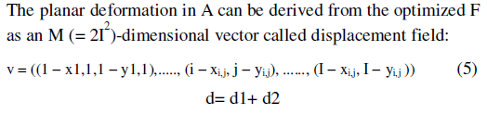

Without Eigen-deformation

Slide 13

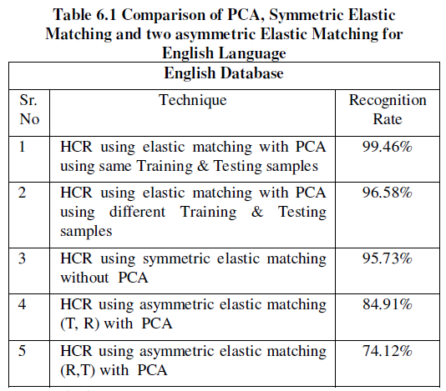

Slide 14

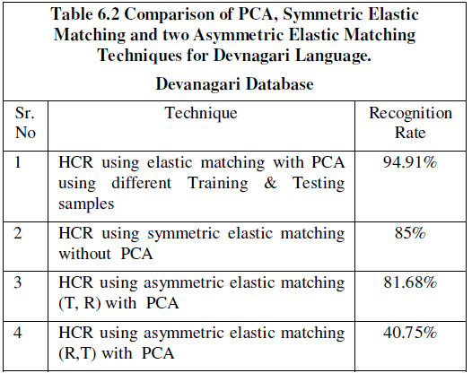
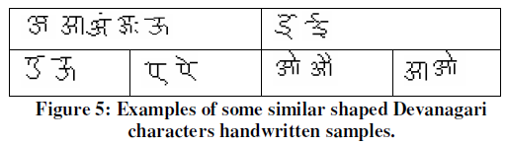
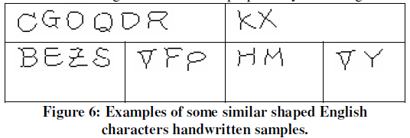

Slide 15

A elastic matching with PCA based system towards the recognition of off-line isolated uppercase English character and Devnagari handwritten character
Depend on the characteristics of the elastic matching emplyed to collect actual deformations

Slide 16

The distribution of the actual deformation is not isotropic and therefore can be approcimated by several principal axes.

